Slide 1
Principles and Methods of Program Design Lecture 5: Collections
Yuting Wang
SEIEE
John Hopcroft Center for Computer Science
2025.3.31

Slide 2
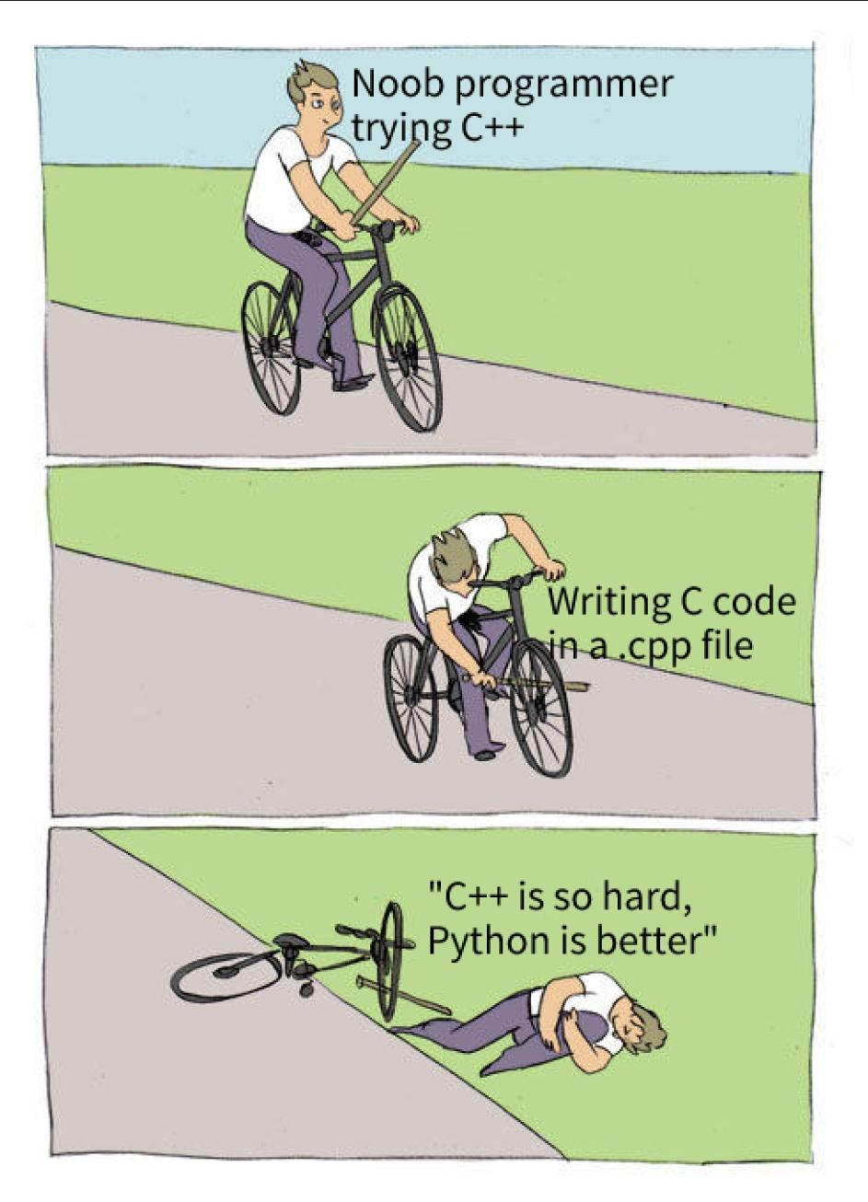

Slide 3
Road Map
Basics of Imperative Programming (C++)
Programming with Abstractions
Implementing Abstractions
Here!

Slide 4
Last Time
Abstract Data Types
Strings
Aliasing of Variables
Streams

Slide 5
This Time
Parametric Polymorphism
C++ Templates
Collections
Iteration & Recursion

Slide 6
Polymorphism

Slide 7
Polymorphism
Polymorphism: a single interface for entities of multiple different types
Three kinds of polymorphism
Ad-hoc polymorphism (Overloading)
Polymorphic functions (ADT) behave differently depending on types
Parametric polymorphism (Templates)
Polymorphic functions (ADT) behave uniformly with different types
Subtyping (Class Inheritence)
Subtypes of an ADT have the same interface, but may behave differently
We delay the discussion of subtyping to later lectures

Slide 8
Ad-hoc Polymorphism
(Overloading)

Slide 9
Overloading
Overloading: Ad-hoc polymorphism in C++
We have seen many examples
Overloaded operators:
<<, >>, +, +=, ==, …
Overloaded methods:
str.insert, str.erase, str.substr, ….
Function Overloading:
A function may have different implementations depending on parameter types

Slide 10
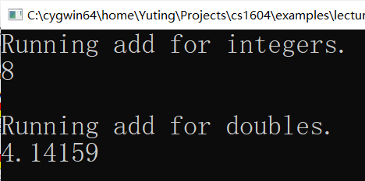
Function Overloading
Overloading with different types
Function names are the same
Function types are different
At call sites:
Choose based on arguments types
int add(int x, int y)
{
cout << "Running add for integers." << endl;
return x + y;
}
double add(double x, double y)
{
cout << "Running add for doubles." << endl;
return x + y;
}
int main()
{
cout << add(3, 5) << endl << endl;
cout << add(1.0, 3.14159) <<endl;
return 0;
}

Slide 11
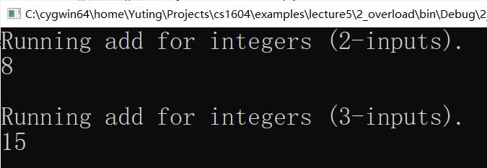
Function Overloading
Overloading with different numbers of parameters:
Function names are the same
Function types are the same
# of parameters are different
At call site:
Choose based on # of arguments
int add(int x, int y)
{
cout << "Running add for integers (2-inputs)."
<< endl;
return x + y;
}
int add(int x, int y, int z)
{
cout << "Running add for integers (3-inputs)."
<< endl;
return x + y + z;
}
int main()
{
cout << add(3, 5) << endl << endl;
cout << add(3, 5, 7) <<endl;
return 0;
}

Slide 12
Parametric Polymorphism
(Templates)

Slide 13
Templates
Templates: parametric polymorphism in C++
Template functions
Syntax:
T is a type parameter
The function prototype or definition may use T as a regular type
The function prototype or definition cannot inspect the internal structure of T
template <typename T>
function prototype/definition
// An identity template function
template <typename T>
T id(T v)
{
return v;
}

Slide 14
Instances of Templates
Given any instances of type parameters, a template generate an instance:
// An identity template function
template <typename T>
T id(T v)
{
return v;
}
T=int
T=char
T=string
// An identity for int
int id(int v)
{
return v;
}
// An identity for char
char id(char v)
{
return v;
}
// An identity for string
string id(string v)
{
return v;
}

Slide 15
Calling Template Functions
At the call sites:
Instances of templates are chosen based on argument types
Explicit instances may be specified
// Calling a template function
cout << id(65) << endl;
cout << id('c') << endl;
string s = "Hello world!";
cout << id(s) << endl;
// Explicit instaniation
cout << id<char>(65) << endl;

Slide 16
Template Swap
Swapping two values may be defined as a template function
We name it as swap_val to avoid conflict with swap in the standard library
template <typename T>
void swap_val(T& t1, T& t2)
{
T temp;
temp = t1;
t1 = t2;
t2 = temp;
}

Slide 17
Calling a Template Function
Every instance of a template works in the same way!
No special treatment for different type parameters
int main()
{
// Swap two integers
int x = 3, y = 5;
cout << "Before swapping: x = " << x << ", y = " << y << endl;
swap_val(x, y);
cout << “After swapping: x = ” << x << “, y = ” << y << endl << endl;
// Swap two strings
string s1 = "Red", s2 = "Blue";
cout << "Before swapping: s1 = " << s1 << ", s2 = " << s2 << endl;
swap_val(s1, s2);
cout << "After swapping: s1 = " << s1 << ", s2 = " << s2 << endl;
return 0;
}

Slide 18
Exercise
How to define a template function for sorting 3 elements
// How to define sort3?
int main()
{
int a = 5, b = 2, c = 10;
sort3(a, b, c); // Sort a, b, c in ascending order
cout << a << " " << b << " " << c << endl;
string s1 = "Red", s2 = "Blue", s3 = "RedBlue";
sort3(s1, s2, s3); // Sort s1, s2, s3 in ascending order
cout << s1 << " " << s2 << " " << s3 << endl;
}

Slide 19
Polymorphic ADT

Slide 20
Template Classes
Abstract data types can also be parameterized over other types
Key Property: Different instances, uniform behavior
Parametric polymorphic ADTs are known as Template Classes in C++
datatype<T>
T=int
T=string
T=char
datatype<int>
datatype<char>
datatype<string>

Slide 21
Collections
Collections: Data structures for representing a collection of values
We will introduce four of them: Vector, Stack, Queue, Map.
Collections may be represented as polymorphic ADTs in C++
We DO NOT need to understand how they are implemented for now
We first learn how to make use of objects of such types
Note:
C++ Standard Template Library (STL) supports all of the collections above

Slide 22
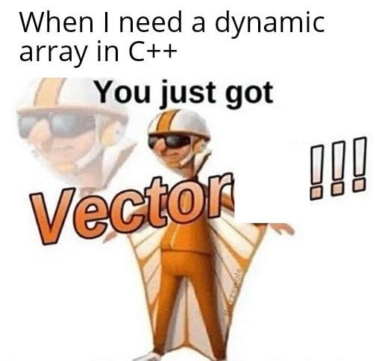
Vectors

Slide 23
Vectors
Vector: A finite sequence of values of the same type
Example: an integer vector of size 7
Syntax for defining vector variables (need to #include<vector>):
Define a empty vector named vec
The vector may only contain elements of type T
Example: vector<int> vec;
34
6
101
-99
42
0
9
0
1
2
3
4
5
6
vector<T> vec;
vector<char> str;

Slide 24
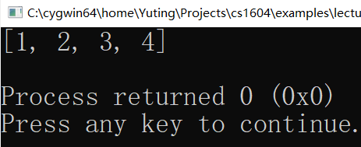
Utilities.h
We provide a set of helper functions
The helper functions will be put into utilities.h
// Printing
vector<int> vec = {1, 2, 3, 4};
cout << vec <<endl;

Slide 25
Add Elements
Appending the value v to the vector vec
vec and v must have compatible type!
The length of vector is NOT fixed:
vec.push_back(v)
// Example
vector<int> vec;
vec.push_back(34);
vec.push_back(6);
vec.push_back(101);
34
6
101
0
1
2
vec.push_back(-99);
34
6
101
-99
0
1
2
3

Slide 26
Selection
The indexing operator [_] is overloaded for vectors
Get value
Set value
Example:
vec[i]
vec[i] = expr;
cout << vec[2] << endl;
34
6
101
-99
0
1
2
3
vec[2] = -13;
34
6
-13
-99
0
1
2
3

Slide 27
Insert and Remove
Insert the value v into vec at an iterator iter
Remove the value at the iterator iter from vec
vec.insert(iter, v)
vec.insert(vec.begin() + 2, 15);
34
6
15
101
-99
0
1
2
3
4
vec.erase(iter)
vec.erase(vec.begin() + 2);
34
6
101
-99
0
1
2
3

Slide 28
What is an iterator?
An object containing a pointer to some element in the vector
We will restrain from using iterators in this course
Read the following tutorial if you are interested
https://www.w3schools.com/cpp/cpp_iterators.asp
Instead, we use the following helper function
vector_insert(vec, 2, 15) // Insert 15 to the 3rd position in vec
vector_erase(vec, 2) // Remove the 3rd element in vec
vec.begin() // Pointing to the first element
vec.begin()+1 // Pointing to the second element
vec.begin()+2 // Pointing to the third element
34
6
15
101
-99
0
1
2
3
4

Slide 29
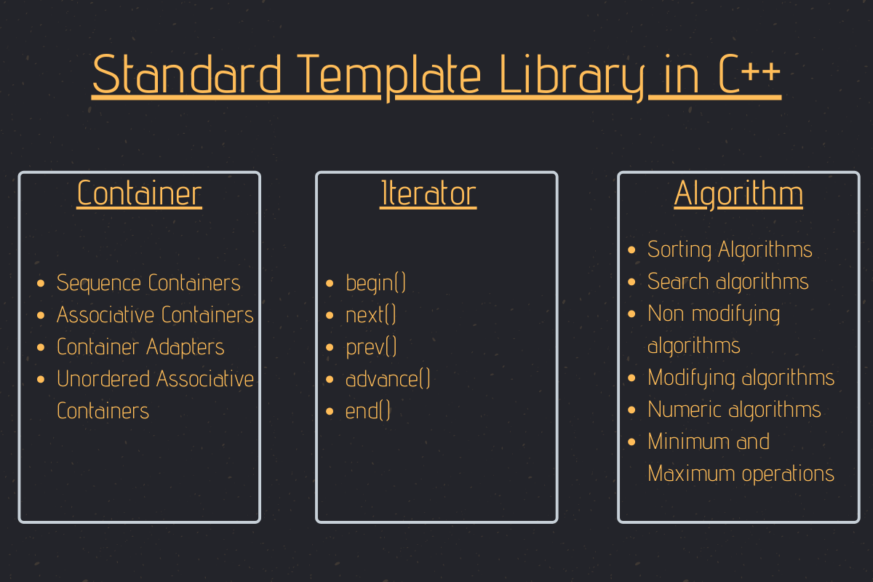

Slide 30
Out of Bounds Error
Be careful of accessing elements out of bounds.
34
6
101
-99
0
1
2
3
// Error: 10 is outside of valid range
vector_insert(vec, 10, 15);
Vector_erase(vec, 10)
cout << vec[10];
vec[10] = 15;

Slide 31
Initialization
Vectors may be initialized with a list
Vectors may be initialized to a given length
vector<T> vec = { … };
// Example
vector<int> vec1 = {42, 0, 9};
vector<T> vec(n, v);
// Example
vector<char> vec1(10, ‘A’);

Slide 32
Concatenation
+, += are overloaded operators for concatenation
Examples:
// Concatenation of vec1 and vec2
vec1 + vec2
// Append vec2 to the end of vec1
vec1 += vec2
34
6
101
-99
+
42
0
9
0
1
2
3
4
5
6
Vector<int> vec1 = {34, 6, 101, -99};
Vector<int> vec2 = {42, 0, 9};
cout << vec1 + vec2 << endl;

Slide 33
Other Operations
size(): get the number of elements
empty(): check if the vector is empty
clear(): remove all the elements

Slide 34
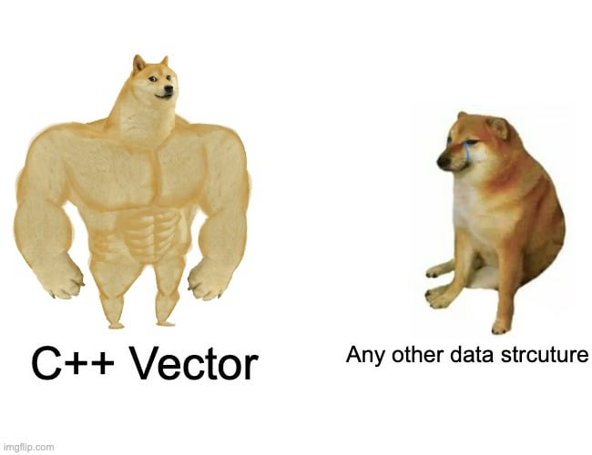
Programming
with Vectors

Slide 35
Iteration
Patterns for iteration over strings are applicable to vectors as well
// Forward iteration
for (int i = 0; i < vec.size(); i++) {
body of the loop that manipulates vec[i]
}
// Backward iteration
for (int i = vec.size()-1; i >= 0; i--) {
body of the loop that manipulates vec[i]
}
// Iterative concatenation
for (loop condition) {
vec += the next vector
}

Slide 36
Example: Filtering
Given a vector of integers, remove all the negative values in it
Question: Why iterate over the vector backwards?
Exercise: What would be a solution that loops forward?
// Remove all negative values in vec
vector<int> removeNegValues(vector<int> vec)
{
for (int i = vec.size()-1; i >= 0; i--) {
if (vec[i] < 0)
vector_erase(vec, i);
}
return vec;
}

Slide 37
Passing References
The previous implementation is not very efficient
The vector is copied twice: one at function call and another at return
Solution: pass references (call-by-value)
// Remove all negative values in vec
void removeNegValues(vector<int>& vec)
{
for (int i = vec.size()-1; i >= 0; i--) {
if (vec[i] < 0)
vector_erase(vec, i);
}
}

Slide 38
Exercise: Concatenation
Given a vector of strings, how to concatenate them into a single string where adjacent elements are separated by a single space?
string concatStrings(vector<string> words)
{
string result;
// Fill in the code here
return result;
}

Slide 39
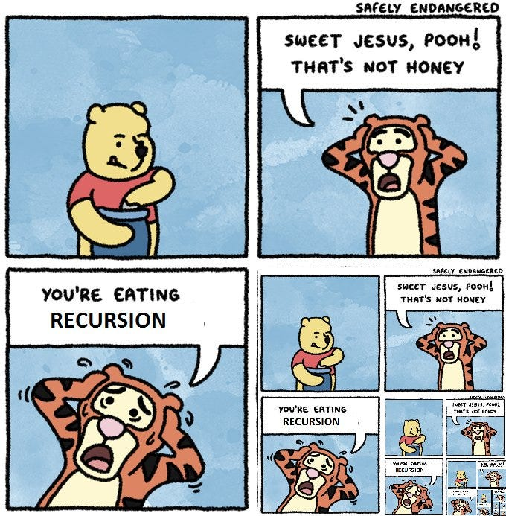

Slide 40



Recursion
Recursion over vectors work as before
Break a problem about vector into problems about smaller vectors
Get an immediate solution at base cases
Compose the results of sub-problems to solve the original problem
Original Problem:
$$S$$
Sub Problems:
$$S_{1}$$
$$S_{2}$$
● ● ●
$$S_{n}$$
Base Cases:
● ● ●

Slide 41
Example: Filtering
Recursively remove all negative values in a vector
// Remove all negative values in vec
vector<int> removeNegValues(vector<int> vec)
{
if (vec.empty())
return vector<int>();
else {
vector<int> head;
// Keep vec[0] if it is not a negative value
if (vec[0] >= 0) head.push_back(vec[0]);
// Get the remaining elements
vector_erase(vec, 0);
vector<int> rest = removeNegValues(vec);
return head + rest;
}
}

Slide 42
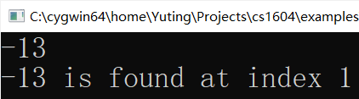
Search for an Element
Given a vector, we would like to find a specified value v in it
A straightforward solution: linear search
Q: What is the result of cout << find_element(v, -13)
42
-13
101
-99
42
0
9
0
1
2
3
4
5
6
// Linear search
int find_element(const vector<int>& vec, int v) {
for (int i = 0; i < vec.size(); i++)
if (vec[i] == v)
return i;
return -1;
}

Slide 43
Search a Sorted Vector
Assume a sorted vector, we would like to find a specified value in it
Can we do better than linear search?
Yes! Use binary search
-99
-13
0
9
42
42
101
0
1
2
3
4
5
6

Slide 44
Binary Search
Binary search is easily described using a recursive process
Find the middle element, if equal the search ends
If bigger than the given value, search the lower half, search the upper half o.w.
Example: find -13
-99
-13
0
9
42
42
101
Middle element is 9;
-13 < 9
0
1
2
3
4
5
6
-99
-13
0
Middle element is -13
0
1
2

Slide 45
Recursive Solution
// Search for v in vec[st…ed]
int binary_search_rec(const vector<int>& vec, int v, int st, int ed)
{
if (ed < st)
return -1;
int mid = (st+ed)/2;
if (vec[mid] == v)
return mid;
else if (v < vec[mid])
return binary_search_rec(vec, v, st, mid-1);
else
return binary_search_rec(vec, v, mid+1, ed);
}

Slide 46
Iterative Solution
Exercise: complete the while loop
Question: What is the loop invariant?
int binary_search_iter(const Vector<int>& vec, int v)
{
int st = 0, ed = vec.size()-1;
while (st <= ed) {
???
}
return -1;
}

Slide 47
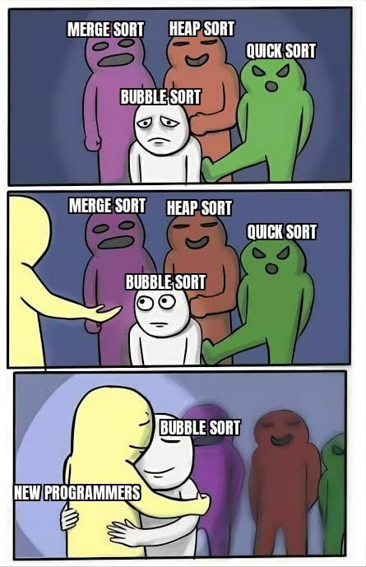
Sorting

Slide 48
Sorting
Sorting a sequence of integers in ascending order
42
-13
101
-99
42
0
9
0
1
2
3
4
5
6
-99
-13
0
9
42
42
101
0
1
2
3
4
5
6

Slide 49
Bubble Sort
Idea: repeatedly reorder adjacent elements if they are out of order
42
-13
101
-99
42
0
9
0
1
2
3
4
5
6
-13
42
101
-99
42
0
9
0
1
2
3
4
5
6
-13
42
101
-99
42
0
9
0
1
2
3
4
5
6
-13
42
-99
101
42
0
9
0
1
2
3
4
5
6

Slide 50
Pseudo Code
Given a vector vec:
void bubble_sort(vector<int>& vec)
{
while (vec is not sorted){
Check every adjacent pair of elements in vec
If they are out of order, swap their values
}
}

Slide 51
Check if Sorted
Note the early exit pattern
// Check if vec is sorted in ascending order
bool is_sorted(const vector<int>& vec)
{
for (int i = 0; i < vec.size()-1; i++)
if (vec[i] > vec[i+1])
return false;
return true;
}

Slide 52
Bubble Sort in C++
Implementation in C++:
void bubble_sort(vector<int>& vec)
{
while (!is_sorted(vec)) {
for (int i = 0; i < vec.size()-1; i++) {
if (vec[i] > vec[i+1]) {
int temp = vec[i];
vec[i] = vec[i+1];
vec[i+1] = temp;
}
}
}
}
swap(vec[i], vec[i+1]);

Slide 53
Is the Implementation Optimal?
Observation: every iteration pushes the next greatest value that is out-of-place to its rightful place
42
-13
101
-99
42
0
9
0
1
2
3
4
5
6
-13
42
-99
42
0
9
101
0
1
2
3
4
5
6
-13
-99
42
0
9
42
101
0
1
2
3
4
5
6

Slide 54
Optimized Bubble Sort
In the worst case, iterations are needed!
Question: Is there any missed optimization?
n-1
void bubble_sort(vector<int>& vec)
{
for (int k = 0; k < vec.size()-1; k++){
for (int i = 0; i < vec.size()-1; i++) {
if (vec[i] > vec[i+1])
swap(vec[i], vec[i+1]);
}
}
}

Slide 55
Loop Invariants
Q: What is the loop invariant for bubble sort?
void bubble_sort(vector<int>& vec)
{
for (int k = 0; k < vec.size()-1; k++){
// vec starting from vec.size()-k-1 is sorted
for (int i = 0; i < vec.size()-1; i++) {
if (vec[i] > vec[i+1])
swap(vec[i], vec[i+1]);
}
}
// vec is sorted
}
// What is the loop invariant about vec?

Slide 56
Check Sortedness
Generalization of is_sorted
// vec starting from the index start is sorted
bool is_sorted(const Vector<int>& vec, int start)
{
for (int i = start; i < vec.size()-1; i++)
if (vec[i] > vec[i+1])
return false;
return true;
}
i = 0

Slide 57
Loop Invariants
We can use assertion to check if the loop invariant holds
Question: Is there any missed optimization?
Answer: The inner loop only need to iterate for n-k-1 times!
void bubble_sort(Vector<int>& vec)
{
for (int k = 0; k < vec.size()-1; k++) {
assert(is_sorted(vec, vec.size()-k-1));
for (int i = 0; i < vec.size()-1 ; i++) {
if (vec[i] > vec[i+1])
swap(vec[i], vec[i+1]);
}
}
assert(is_sorted(vec, 0));
}
-k

Slide 58
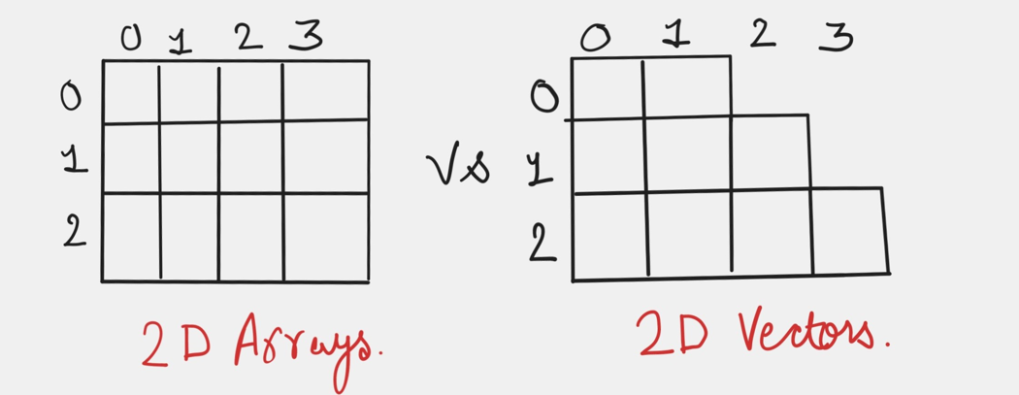
Higher-Dimension Vectors

Slide 59
2-Dimension Vectors
A 2-dimension vector is a vector containing vectors
Elements may have the same length or NOT
// Examples
vector<vector<int>> emptyGrd;
vector<vector<int>> NonemptyGrd(3, vector<int>(4));
cout << emptyGrd << endl;
cout << NonemptyGrd << endl;
vector<int> v1 = {1, 2, 3};
vector<int> v2 = {9, 9, 9, 9, 9, 9, 9};
vector<int> v3 = {5};
emptyGrd.push_back(v1);
emptyGrd.push_back(v2);
emptyGrd.push_back(v3);

Slide 60
Subsequences
Find all the subsequences of a vector
42
-13
101
It has subsequences:
42
-13
101
42
-13
101
42
-13
101
(42)
(-13)
(-101)
42
-13
101
42
-13
101
42
-13
101
(42，-13)
(-13，101)
(42，-101)
42
-13
101
42
-13
101
(42，-13，-101)
()

Slide 61
A Recursive Solution
If the vector is empty, the solution is trivial
If not, break the vector into a head and tail
Sub Problem
Subsequences
Of {-13, 101}:
-13
101
Recursive
solution
{}
{-13}
{101}
{-13,101}
Original Problem
42
-13
101
Final result
{42}
{42, -13}
{42, 101}
{42, -13,101}

Slide 62
Adding a Head
The subsequences are stored in a 2-dimension vector
// Add v to the head of vectors in vecs
vector<vector<int>> addHead
(int v, const vector<vector<int>>& vecs)
{
vector<vector<int>> result;
for (int i = 0; i < vecs.size(); i++) {
vector<int> vec = vecs[i];
vector_insert(vec, 0, v);
result.push_back(vec);
}
return result;
}

Slide 63
Get Subsequences
Implements the recursive solution
Unfortunately, there is a bug in this implementation, can you find it?
vector<vector<int>> getSubseq(const vector<int>& vec)
{
if (vec.empty()) {
vector<vector<int>> emptySeq= {};
return emptySeq;
}
else {
// Get the subsequences of the tail
vector<int> svec = vec;
vector_erase(svec, 0);
vector<vector<int>> tvecs = getSubseq(svec);
vector<vector<int>> hvecs = addHead(vec[0], tvecs);
return tvecs + hvecs;
}
}

Slide 64
Challenge
Implement the iterative version of getSubseq

Slide 65
Tic-Tac-Toe
Tic-Tac-Toe Game
“two players who take turns marking the spaces in a three-by-three grid with X or O. ”
Example:
X
X
O
X
O
X
O
X
X
O
X
O
O
X
O
O
X
O
X has won!
X
X
X
X
X
O
X
O
X
O

Slide 66
Implementation
The main logic of the game resides in the following loop
Query for the input from the current player
The current player places X or O on the board at a given coordinate
Check if the current player has won the game
If so, game ends
If not, the other play takes over, go back to Step 1

Slide 67
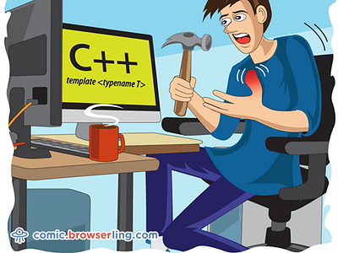
Template Functions

Slide 68
Duplication of Functions
Operations for different instances of poly ADTs may behave the same
Example: reverse a vector
// Reverse vectors of ints
vector<int> reverseVectorInt
(const vector<int>& vec) {
vector<int> result;
for (int i = vec.size()-1; i >= 0; i--)
result.push_back(vec[i]);
return result;
}
// Reverse vectors of strings
vector<string> reverseVectorString
(const vector<string>& vec) {
vector<string> result;
for (int i = vec.size()-1; i >= 0; i--)
result.push_back(vec[i]);
return result;
}

Slide 69
Generic Procedures
A single function that captures a collection of equivalent operations under different type instances
Example: template function for reversing vectors:
// Reverse a vector of type T
template<class T>
vector<T> reverseVector(const vector<T>& vec)
{
vector<T> result;
for (int i = vec.size()-1; i >= 0; i--)
result.push_back(vec[i]);
return result;
}

Slide 70
Another Example
Generic operation on 2-dimension vectors
// Get subsequences of a vector
template<class T>
vector<vector<T>> getSubseq(const vector<T>& vec)
{
if (vec.empty()) {
vector<vector<T>> emptySeq= {{}};
return emptySeq;
}
else {
vector<T> svec = vec;
vector_erase(svec, 0);
vector<vector<T>> tvecs = getSubseq(svec);
vector<vector<T>> hvecs = addHead(vec[0], tvecs);
return tvecs + hvecs;
}
}

Slide 71
Exercises
Try to define template functions for the following operations
Concatenate two vectors
Linear search of a vector
Binary search of a vector
Finding all the permutation of a vector

Slide 72
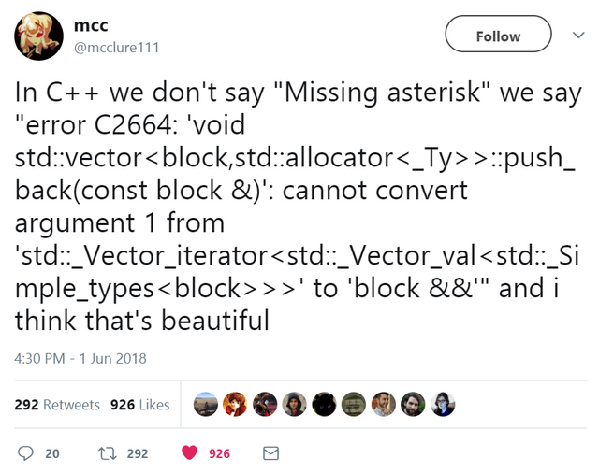
Template Errors

Slide 73
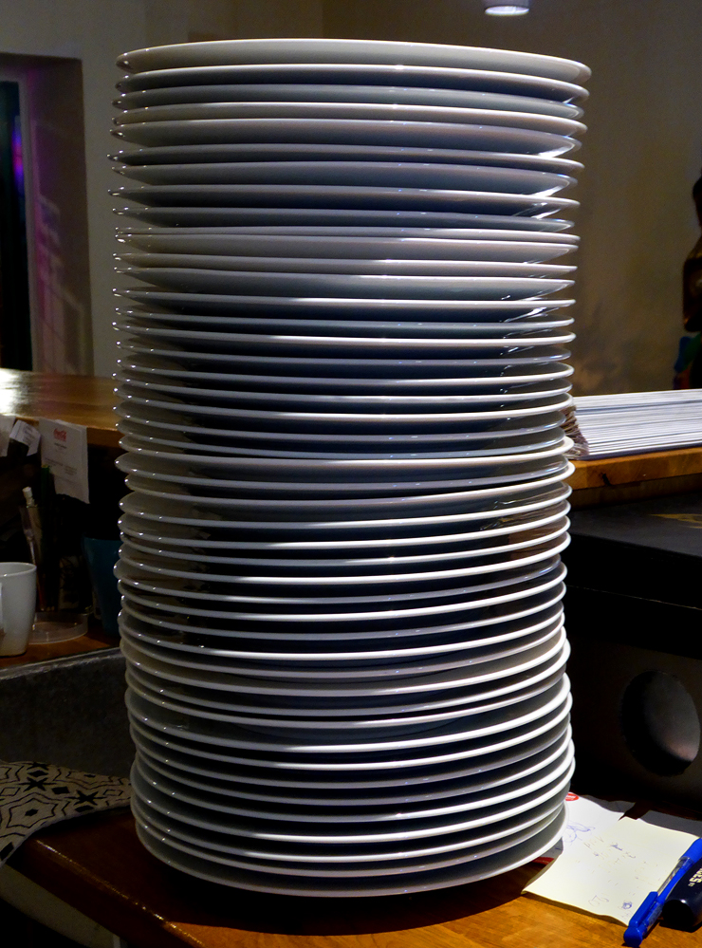
Stack

Slide 74
Structure of Stacks
A stack stores a sequence of values
Must be added and removed from the top
No way to look into the element below the top one
E
D
C
C
E
B
B
B
B
A
A
A
A

Slide 75
Stack ADT
Syntax (need to include in <stack>):
Key operations:
push(value)
Push value on top of the stack (value becomes the topmost element)
top()
Return the topmost element
pop()
Remove the topmost element
Note: top and pop cause an error for empty stacks
// Define an empty stack s of type T
stack<T> s;

Slide 76
Example
// Initialize an empty stack
stack<char> s;
cout << s << endl;
// Push values
s.push('A');
s.push('B');
s.push('C’);
// Print the topmost element
cout << s.top() << endl;
// Pop the topmost element
s.pop();
cout << s << endl;
// More pops
s.pop();
s.pop();
// Errors: popping and peeking empty stacks
s.pop();
s.top();

Slide 77
Iteration of Stacks
Iteration can only be accomplished destructively
Pattern:
// Iterate over the stack s
while (!s.empty()) {
int v = s.pop();
perform operation on v;
}

Slide 78
Reverse Strings
Reverse a string by using a stack
//Reverse a string
string reverseString(const string& str)
{
// rev stores str in reverse order
stack<char> rev;
for (int i = 0; i < str.length(); i++)
rev.push(str[i]);
// transform rev into a string
string result;
while (!rev.empty()) {
char ch = rev.top();
result += ch;
rev.pop();
}
return result;
}

Slide 79
Exercise
How to use a stack to check if a string is a palindrome?
// Check if a string is a palindrome
bool isPalindrome(const string& str)
{
// rev stores str in reverse order
stack<char> rev;
for (int i = 0; i < str.length(); i++)
rev.push(str[i]);
bool result;
// Fill in here
return result;
}

Slide 80
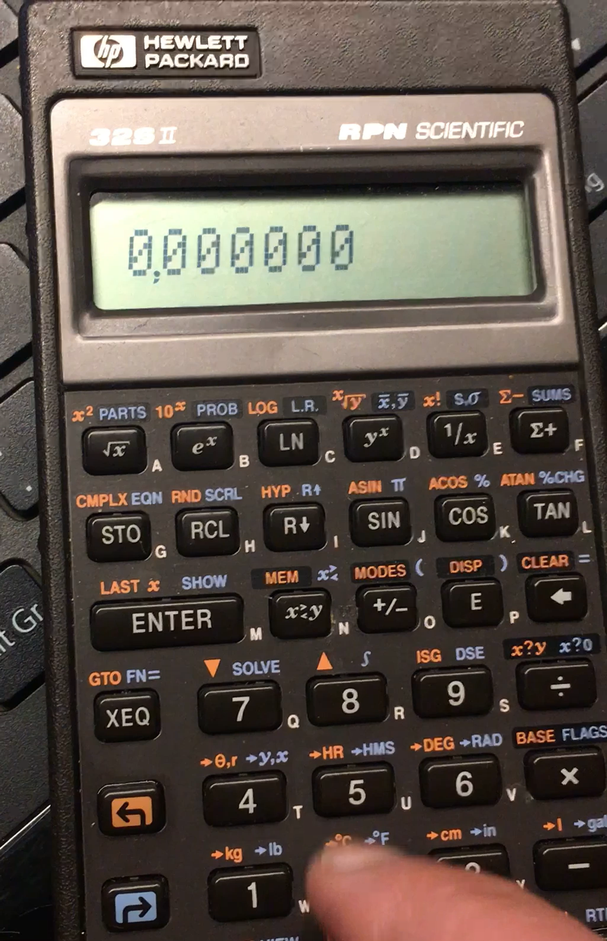
More Applications
of Stacks

Slide 81
RPN Calculator
RPN (reverse Polish notation) calculator is a class of calculators
Read an operator only after ALL of its operands are supplied
Example:
Regular form:
3.14 * 5.0 * 5.0 + 1.72 / 2.0
Explicit Precedence:
((3.14 * 5.0) * 5.0) + (1.72 / 2.0)
RPN:
((3.14 5.0 *) 5.0 *) (1.72 2.0 /) +

Slide 82
Computation via a Stack
Use a stack to store the operands and immediate values
Example:
((3.14 5.0 *) 5.0 *) (1.72 2.0 /) +
3.14
5.0
*
5.0
*
1.72
2.0
/
+
2.0
5.0
5.0
1.72
1.72
0.86
3.14
3.14
15.7
15.7
78.5
78.5
78.5
78.5
79.35

Slide 83
Single Operations
// Perform operation op and check if succeeded
bool calculate(Stack<double>& vstack, char op, double& result)
{
if (vstack.size() < 2) return false;
double v2 = vstack.top(); vstack.pop();
double v1 = vstack.pop(); vstack.pop();
switch (op) {
case '+':
result = v1 + v2;
break;
…
default:
return false;
}
vstack.push(result);
return true;
}

Slide 84
Main Loop
stack<double> vstack; // Stack of values
string input; // User input
double result; // Intermediate result
// Main loop
while (true) {
getline(cin, input);
if (input == "Quit") break;
if (input == "Print") {
cout << vstack << endl;
continue;
}
if (isdigit(input[0]))
vstack.push(atof(input.c_str()));
else if (calculate(vstack, input[0], result))
cout << result << endl;
else {
cout << "Error encountered!" << endl;
return -1;
}
}

Slide 85
Tower of Hanoi Revisited
Assume the disks are numbered in the tower of Hanoi
When moving disk n to from X to Y, we would like to print
Move disk n: X -> Y
1
2
3
4
5
A B C

Slide 86

Queue

Slide 87
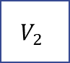
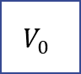
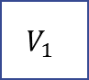

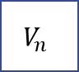

Structure of Queues
A queue stores a sequence of values
A value can only be added from the tail
A value can only be fetched from the head
$$V_{0}$$
enqueue
$$V_{n}$$
$$…$$
$$V_{2}$$
$$V_{2}$$
$$V_{1}$$
dequeue
head
tail
Structure of a Queue

Slide 88
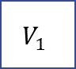
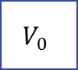





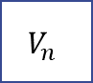
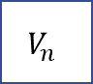



FIFO and LIFO
Stack is a last-in-first-out (LILO) data structure
Queue is a first-in-first-out (FIFO) data structure
$$V_{0}$$
push
A Stack
$$V_{n}$$
$$…$$
$$V_{2}$$
$$V_{2}$$
$$V_{1}$$
bottom
top
pop
$$V_{0}$$
enqueue
A Queue
$$V_{n}$$
$$…$$
$$V_{2}$$
$$V_{2}$$
$$V_{1}$$
dequeue
head
tail

Slide 89
Queue ADT
Syntax (need to include in <queue>):
Key operations:
push(value)
Add value to the tail of the queue
top()
Return the head element
pop()
Remove the head element
Note: top and pop cause an error for empty queues
// Define an empty queue q of type T
queue<T> q;

Slide 90
Example
// Initialize an empty queue
queue<int> q;
cout << q << endl;
// Add values
q.push(1);
q.push(2);
q.push(3);
cout << q << endl;
// Print the head element
cout << q.front() << endl;
// Remove the head element
q.pop();
cout << q << endl;
// More dequeues
cout << q.front() << endl;
q.pop();
cout << q.front() << endl;
q.pop();

Slide 91



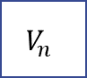

Applications of Queues
Filtering
Feed a sequence of elements into a queue and filter out certain class of elements
Routing & Scheduling
Collect elements from incoming channels and dispatch them to outgoing channels
Dequeue &
filter
$$V_{n}$$
$$…$$
$$V_{2}$$
$$V_{2}$$
$$V_{1}$$
feed
head
tail
Router/
Scheduler
Outgoing channels
Incoming channels

Slide 92
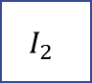

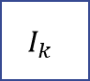





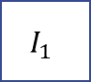
Filtering Negative Values
Generator: generates N integers between (-100, 100)
Filter: filter out all negative values
Generator
$$V_{n}$$
$$…$$
$$V_{2}$$
$$V_{2}$$
$$V_{1}$$
Filter
head
tail
$$I_{1}$$
$$I_{2}$$
$$…$$
$$I_{k}$$

Slide 93
Implementation
Randomly generate N integers (use random_integer in utilities.h)
Filter out all negative integers
void generateIntegers(int n, queue<int>& q) {
for (int i = 0; i < n; i++)
q.push(random_integer(-100, 100));
}
Vector<int> filterNegInts(queue<int>& q) {
vector<int> result;
while (!q.empty()) {
int v = q.front();
q.pop();
if (v >= 0)
result.push_back(v);
}
return result;
}

Slide 94
Implementation
Main Function
// Generate and filter out negative values
int main()
{
int n = 10;
queue<int> q;
generateIntegers(n, q);
cout << "The original values are: " << q << endl;
Vector<int> filtered = filterNegInts(q);
cout << "The filtered values are: " << filtered;
return 0;
}

Slide 95

Simulation

Slide 96
Simulation
Operations on queues often happen at real time
We design discrete-time models to simulate such operations
A global clock records the current time
An operation may (repeatedly) happen at certain times
A loop simulates the progress of time
Every loop represent passing of one tick
Operation 1
+1s
……
Operation n

Slide 97

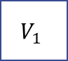



Simulation of a Filter
We use the filter of negative values as an example
At every tick
The generator may enqueue a value if it is time
The filter may filter a value if it is time
Generator
$$V_{n}$$
$$…$$
$$V_{2}$$
$$V_{2}$$
$$V_{1}$$
Filter
head
tail
$$I_{1}$$
$$I_{2}$$
$$…$$
$$I_{k}$$

Slide 98
A Global Clock
We use a global counter to represent the clock
We define the speed of every operation
// Global clock
int CLOCK = 0;
// Filter runs every 3 ticks
const int FILTER_TIME = 3;
// Generator runs every 2 tick
const int GENINT_TIME = 2;

Slide 99
Simulation of the Integer Generator
Generates an integer and add to the queue if it is the time
// Generator
bool generateInteger(queue<int>& q)
{
if (CLOCK % GENINT_TIME != 0)
return false;
int v = random_integer(-100, 100);
cout << "Generated: " << v << endl;
q.push(v);
return true;
}

Slide 100
Simulation of the Filter Function
Read from the queue and filter the value if it is the time
// Filter
bool filterNegInt(queue<int>& q, vector<int>& res)
{
if (CLOCK % FILTER_TIME != 0)
return false;
if (q.empty()) {
cout << "Nothing to filter" << endl;
return false;
}
else {
int v = q.front();
q.pop();
if (v >= 0) {
res.push_back(v);
cout << "Kept: " << v << endl;
} else
cout << "Discarded: " << v << endl;
return true;
}
}

Slide 101
Simulation Loop
// Simulation loop, n denotes the # of integers to be generated
void simulate(int n) {
queue<int> q; vector<int> vec;
// i denotes the number of integers already generated
int numGen = 0;
// Every loop performs an operation if it is ready
while (true) {
CLOCK++;
cout << "Time (ticks): " << CLOCK << endl;
// Run the generator
if (numGen < n && generateInteger(q))
numGen++;
// Run the filter
filterNegInt(q, vec);
cout << "---------------------" << endl;
// All numbers has been generated and filtered
if (numGen == n && q.empty())
break;
}
cout << "The final result is: " << vec << endl;
}

Slide 102
Queue for Algorithms
Many algorithms need queues
Breadth First Search
Edmond Karp Algorithm
Fibonacci Heap
….
We will not further delve into non-trivial algorithms
Instead, we revisit a previous problem …

Slide 103
Find Subsequences
Find all the subsequences of a vector
The subsequences of {42, -13, 101} are
We have seen a recursive solution using 2-dimension vectors
We can also have an iterative solution (assume there is N elements)
For 0 to (N-1)-th elements, we can either choose to include the element or not
Every unique sequence of choices result in a distinct subsequence
{}
{42}
{-13}
{101}
{42，-13}
{-13，101}
{42，101}
{42，-13，101}

Slide 104
Iterative Solution
{}
{}
{101}
{}
Not include the 0-th element
{-13}
{-13}
{-13, 101}
42
-13
101
{}
{42}
Include the 0-th element
{42}
{42, 101}
{42}
{42,-13}
{42,-13}
{42,-13,101}

Slide 105
Implementation
i=3(done)
i=2
{}
// Iteratively find subsequences
queue<vector<int>> findSubseqs
(const vector<int>& vec) {
Queue<Vector<int>> subSeqs;
subSeqs.push_back(vector<int>());
for (int i = 0; i < vec.size(); i++) {
// subSeqs contains i-th column
int n = subSeqs.size();
for (int j = 0; j < n; j++) {
Vector<int> s = subSeqs.front();
subSeqs.pop();
// Not include the i-th element
subSeqs.push(s);
// Include the i-th element
s.push_back(vec[i]);
subSeqs.push(s);
}
}
return subSeqs;
}
i=1
{}
i=0
{101}
{}
{-13}
{-13}
{-13, 101}
{}
{42}
{42}
{42, 101}
{42}
{42,-13}
{42,-13}
{42,-13,101}

Slide 106
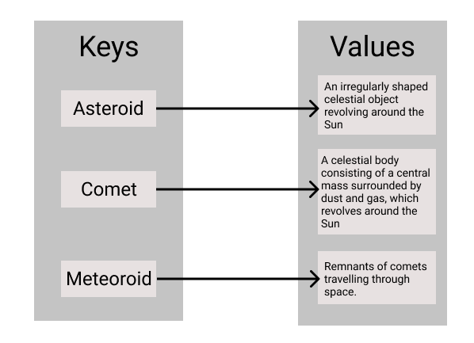
Map

Slide 107
Structure of Maps
Map: a collection of pairs
The first element is called the key
The second element is called the value
Usage: look up a value by supplying a key
Examples: dictionaries, address books, menus
Keys(name) Values (price per kilo)
“Cabbage” → 11.4
“Pork” → 17.6
“Beef” → 20.1

Slide 108
Map ADT
Syntax (need to include in <map>):
Note: the ordering of pairs are not important
The following maps behave equivalently
// Define an empty map m from K to V
map<K, V> m;
// Define a map with initial pairs
map<K, V> m = {{k1, v1}, …, {kn, vn}};
map<string, double> m1 = {{“Cabbage”, 11.4},
{“Pork”, 17.6},
{“Beef”, 20.1}};
map<string, double> m2 = {{“Beef”, 20.1},
{“Pork”, 17.6},
{“Cabbage”, 11.4}};

Slide 109
Put
Add a key value pair to the map
Replace old pair if the key is defined
Add a new pair if the key is not defined
Keys Values
“Cabbage” → 11.4
“Pork” → 17.6
“Beef” → 20.1
Keys Values
“Cabbage” → 11.4
“Pork” → 17.6
“Beef” → 19.0
m[“Beef”] = 19.0
Keys Values
“Cabbage” → 11.4
“Pork” → 17.6
“Beef” → 20.1
Keys Values
“Cabbage” → 11.4
“Pork” → 17.6
“Beef” → 20.1
“Lamb” → 22.2
M[“Lamb”] = 22.2

Slide 110
Get
m.[key]: return the value associated to the key in the map
Return the current value if the key is defined
Return a default value if the key is not defined
The default value is also inserted
Keys Values
“Cabbage” → 11.4
“Pork” → 17.6
“Beef” → 20.1
m[“Beef”] = 20.1
Keys Values
“Cabbage” → 11.4
“Pork” → 17.6
“Beef” → 20.1
M[“Lamb”] = 0

Slide 111
Remove
m.erase(key): remove the pair associated with key in the map
Remove the value alongside the key if it is defined
Does nothing if the key is not defined
Keys Values
“Cabbage” → 11.4
“Pork” → 17.6
“Beef” → 20.1
Keys Values
“Cabbage” → 11.4
“Pork” → 17.6
m.erase(“Beef”)
Keys Values
“Cabbage” → 11.4
“Pork” → 17.6
“Beef” → 20.1
Keys Values
“Cabbage” → 11.4
“Pork” → 17.6
“Beef” → 20.1
m.erase(“Lamb”)

Slide 112

Morse Code

Slide 113
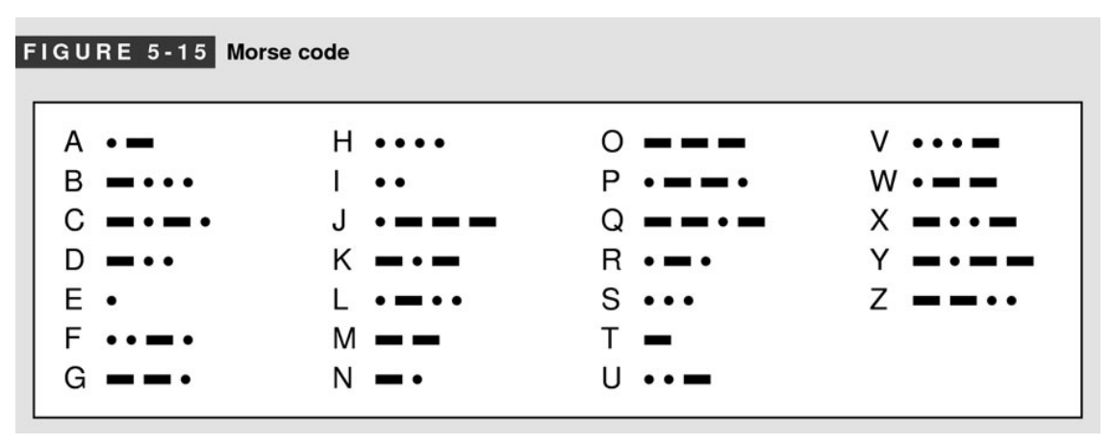
Morse Code
Represent each letter with a sequence of long and short signals (also know as dots and dashes)
The sequences of dots and dashes are separated by spaces
Example: “CHINA” is encoded as
—•—• •••• •• —• •—

Slide 114
Representation
Use a map to store the encoding of each letter
Morse code map is created as follows:
// Mapping from letter to morse code
// true represent a dash, false a dot
map<char, vector<bool>> morseCodeMap;
// Create the map for morse code
map<char, vector<bool>> createMap()
{
map<char, vector<bool>> m = {;
{'A', {false, true}},
{'B', {true, false, false, false}},
{'C', {true, false, true, false}},
...
};
return m;
}

Slide 115
Encoding a Single Letter
// Encode a letter ch into morse code
string encodeLetter(MorseCodeMap& m, char ch)
{
vector<bool>& v = m[ch];
string result;
for (int i = 0; i < v.size(); i++) {
if (v[i])
result += '-';
else
result += '.';
}
return result;
}

Slide 116
Encoding a String
Q: any problem with the implementation? If so, how to fix them?
// Encode a string into morse code
string encodeString(MorseCodeMap& m, const string& str)
{
string result;
for (int i = 0; i < str.size(); i++) {
char ch = str[i];
string s = encodeLetter(m, ch);
if (s.empty())
return "";
result += s + " ";
}
return result;
}

Slide 117
Next Time
Designing ADT/Classes
Object Initialization and Finalization
Operator Overloading
Interfaces vs. Implementations
You should read Chapter 6 in the text book

